Slide 1
Voice Controlled Robotic Vehicle
Submitted in the partial fulfillment for the award of the degree of
BACHELOR OF ENGINEERING
IN
COMPUTER SCIENCE ENGINEERING (Hons.) AI-ML
Submitted by:
Asmeet Kaur Kainth (21BCS10508)
Hetashi Guru Singh Pal (21BCS9888)
Mohammad Basim Siddiqui (21BCS9877)
Raj Faujdar (21BCS9535)
Under the Supervision of:
Mr. Anuj Kumar Raghav
Department of AIT-CSE
DISCOVER . LEARN . EMPOWER

Slide 2
Outline
Introduction to Project
Problem Formulation
Objectives of the work
Methodology used
Results and Outputs
Conclusion
Future Scope
References

Slide 3
Introduction to Project
Voice Controlled CAR is a mobile robot whose movement can be controlled by the commander by giving specific voice commands.
The speech is received by a microphone and processed by the Bluetooth module (hc- Speech recognition is a technology where the system understands the words given through speech.)
The mobile application is capable of identifying five commands which are “Stop”, “Forward”, “Back”, “Left”, and “Right”.

Slide 4
Introduction to Project (continued…)
In this embedded system, we make a robotic car that we can control using voice through a mobile application.
Application listens and sends the instruction to the Arduino using Bluetooth and then Arduino performs the specified operations using a voice recognition application which is not 100% accurate.
The application is sensitive to the surrounding noises. It sometimes misinterprets the voice commands given to the robot.

Slide 5
Problem Formulation
The project’s main objective is to control the robotic vehicle in a desired position.
The goal of the voice-controlled Robot is to listen and act on the commands received from the user.
Human Robotic Interaction is achieved.

Slide 6
Problem Formulation (continued…)
The proposed system consists of a transmitter, a receiver block, and a battery for the power source.
Using this application we can control the robotic vehicle by using a personal phone.
The project is designed to control a robotic vehicle by voice commands and manual control for remote operation.

Slide 7
Objectives of the Work
The objectives of a Voice Controlled Robotic Vehicle using arduino and IoT are as follows:
1.Design and development of a robotic vehicle : To meet the project requirements, the robotic vehicle should be designed and developed. The vehicle should be able to move in multiple directions, have a strong structure to hold objects, and be equipped with sensors to detect and navigate around obstacles.
2.Integration of voice control technology : To receive voice commands from an Android application, the vehicle should be outfitted with voice control technology. The technology should be capable of accurately recognizing various voice commands.
3.Development of an android application : To send voice commands to the robotic vehicle, an Android application should be created. The application should have an easy-to-use interface and be able to establish a reliable connection with the vehicle.
4.Testing and validation : To make sure that the robotic vehicle fulfils the requirements of the project, it should be properly tested. The application should be tested to ensure that it works properly, is reliable, and is compatible with the robotic vehicle.

Slide 8
Methodology used
Hardware and Software Requirements
Hardware Requirements: The required hardware for this project is Arduino UNO, Motor Driver IC, Bluetooth Device Module, DC Motor, Battery, Voltage Regulator, Wheels.
Software requirements: Ubidots, MC Programming Language: Embedded C, Arduino IDE, MIT App Inventor for Bluetooth Voice Controlled app.

Slide 9
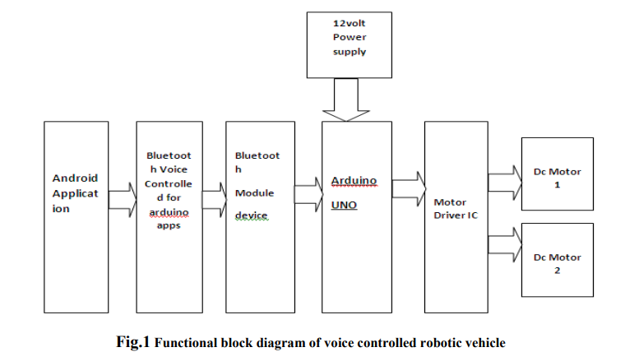
Methodology used (continued…)
Project Block Diagram

Slide 10
Methodology used (continued…)
The basic block diagram of the simple voice-controlled robotic vehicle is given it consists of the smartphone that recognizes the voice commands and is being wirelessly transferred to the Bluetooth module HC05.
The module then converts the command to text and the string of characters is sent to the Arduino for further processing.
The Arduino microcontroller decodes the string obtained and correspondingly performs further functions.

Slide 11
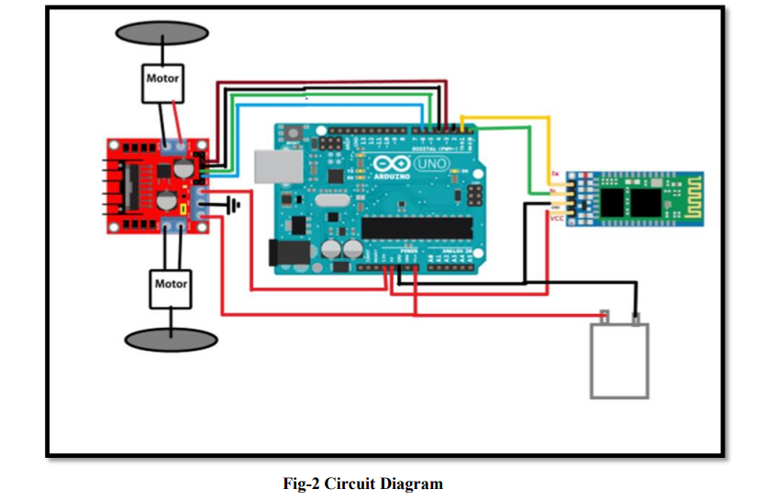
Methodology used (continued…)
Circuit Diagram

Slide 12
Methodology used (continued…)
The DC power supply feeds the Microcontroller and the Bluetooth module.
The Bluetooth module receives the signal sent from an android smartphone, where the application software coded in C language is installed.
The microcontroller, thereby, sends instructions, which when executed, help in the functioning of the motor driver.

Slide 13
Results and Outputs
The proposed system is basically based on Voice Controlled Robotic Vehicle that helps to control the robot through voice commands received via an android application.
The Voice Controlled Vehicle is controlled through voice commands given by the user who is operating the project. These voice command needs to be given through an android app that is installed on the user’s android mobile.
Speech recognition is done within the android app and then a respective command is sent to the voice-controlled robot vehicle. Arduino fitted on the Vehicle decodes these commands and gives an appropriate command to the motors connected to the vehicle.

Slide 14
Results and Outputs (continued…)
Fixed Commands
There are 5 fixed commands which can be used to control basic robot actions:
Up: It is the command to move the robot straight forward unless a new command is sent.
Down: It is the command to move the robot straight backward unless a new command is sent.
Right: It is the command which turns the robot right unless a new command is sent.

Slide 15
Results and Outputs (continued…)
4) Left: It is the command which turns the robot left unless a new command is sent.
5) Stop: It is the command which stop the robot.

Slide 16
Conclusion
The integration of voice recognition and navigation system into a robotic vehicle that helps disabled people.
This speech control system, though quite simple, shows the ability to apply speech recognition techniques to the control application.
Our robot can understand control commands spoken in a natural way, and carry out the action.
The method is proven for real-time operation.

Slide 17
Future Scope
This project work has been narrowed down to a short-range Bluetooth module. Using long-range modules and other connectivity devices will result in connectivity with the robot for long distances.
Power Optimization such as sleep and wakeup schedules can be incorporated.
Image processing can be implemented in the robot to detect the color and the objects.
A thermal camera can be installed to sense the heat emitted by bodies useful for military purposes to detect enemies on the lines.

Slide 18
References
[1]. Othman M.K. Alsmadi, Anas A. Al Jallad, Zaer S. Abo-Hammoud, and Fares J. Al Majali “ArduinoBased Automatic Safety Vehicle Control ” 2nd ICRSET pp.140 March 21-22, 2014 Dubai (UAE)
[2]. Nelson Rai1, Deepak Rasaily 2, Tashi Rapden Wangchuk3, Manoj Gurung4, Rit Kr. Khawas5 “Bluetooth Remote Controlled Car using Arduino” IJETT pp.381 Volume 33 Number 8, March 2016
[3]. Mr. Vedant Chikhale, Mr. Raviraj Gharat, Ms. Shamika Gogate, Mr. Roshan Amireddy “Voice Controlled Robotic System using Arduino Microcontroller” IJNTR Volume- 3, Issue-4 pp. 92-94 April 2017
[4]. Prof. Bhuvaneshwari Jolad1, Mohnish Arora2, Rohan Ganu3, Chetan Bhatia“VOICE CONTROLLED ROBOTIC VEHICLE” IRJET Volume: 04 Issue: 06 pp.191 June-2017
[5]. Soniya Zope1Preeti Muluk2, Rupali Mohite3, Aishwarya Lanke4,Megha Bamankar5 “Voice Control Robot Using Android Application” IJIR pp.1723 Vol-3, Issue-2, 2017
[6]. K. Kannan1, Dr. J. Selvakumar2 “ARDUINO BASED VOICE CONTROLLED ROBOT” IRJET Volume: 02 Issue: 01 pp.49 Mar-2015.
[7]. Subankar Roy #1, Tashi Rapden Wangchuk#2, Rajesh Bhatt#3 “Arduino Based Bluetooth Controlled Robot” IJETT – Volume 32 Number 5- February 2016.

Slide 19
References (continued…)
[8]. P R Bhole1, N L Lokhande2, Manoj L Patel3, V D Rathod4, P R Mahajan5 “Voice Command Based Robotic Vehicle Control” IJRASET ISSN: 2321-9653; IC Value: 45.98; SJ Impact Factor: 6.887 Volume 5 Issue XI November 2017.
[9]. . http://.android.com/about/versions/index.html.
[10]. L298N MOTOR DRIVER:http://buy.flyrobo.in/hc05
[11]. Bluetooth Module:http://buy.flyrobo.in/l298n
[12]. DC Motor:http://buy.flyrobo.in/dc30

